Slide 1
DDDAS Simulational Data

Slide 2
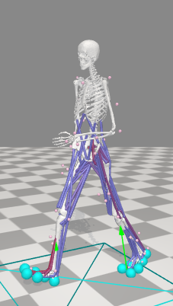
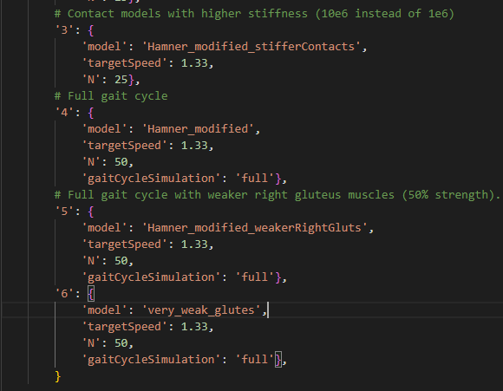
Opensim Simulation

Slide 3
Opensim Simulation Inputs
Mass of the model is 62 kg
getIK(storage_file, joints, degrees=False)
Extracts and optionally converts inverse kinematics (IK) results from a storage file, applying a low-pass filter.
getActivations(storage_file, muscles)
Extracts muscle activations from a storage file.
getGRF(storage_file, headers)
Extracts ground reaction forces (GRF) from a storage file based on specified headers.
getID(storage_file, headers)
Extracts inverse dynamics (ID) results from a storage file for specified headers.
getFromStorage(storage_file, headers)
General-purpose function to extract specified columns from a storage file into a DataFrame.

Slide 4
Opensim Simulation Inputs
getGRM_wrt_groundOrigin(storage_file, fHeaders, pHeaders, mHeaders)
Computes ground reaction moments (GRM) with respect to the ground origin from GRF and point of application data.
getCOP(GRF, GRM)
Calculates the Center of Pressure (COP) and associated torques from GRF and GRM data.
getInitialContact(GRF_y, time, threshold)
Identifies the initial contact index and corresponding time based on GRF exceeding a threshold.
getMomentArmIndices(muscles, leftPolyJoints, rightPolyJoints, polynomialData)
Dictionary mapping joints to muscle affecting them.
solve_with_constraints(opti, tolerance)
Solves an optimal control problem (OCP) using constraints directly.

Slide 5
Opensim Simulation Optimization functions
Get the Experimental Data
Convert to pandas and Numpy Dataframes for computation
Interpolate some data to create continuous data
Identify constraints to optimize various parameters
Feed input data and the constraints to solve the optimal control problem

Slide 6
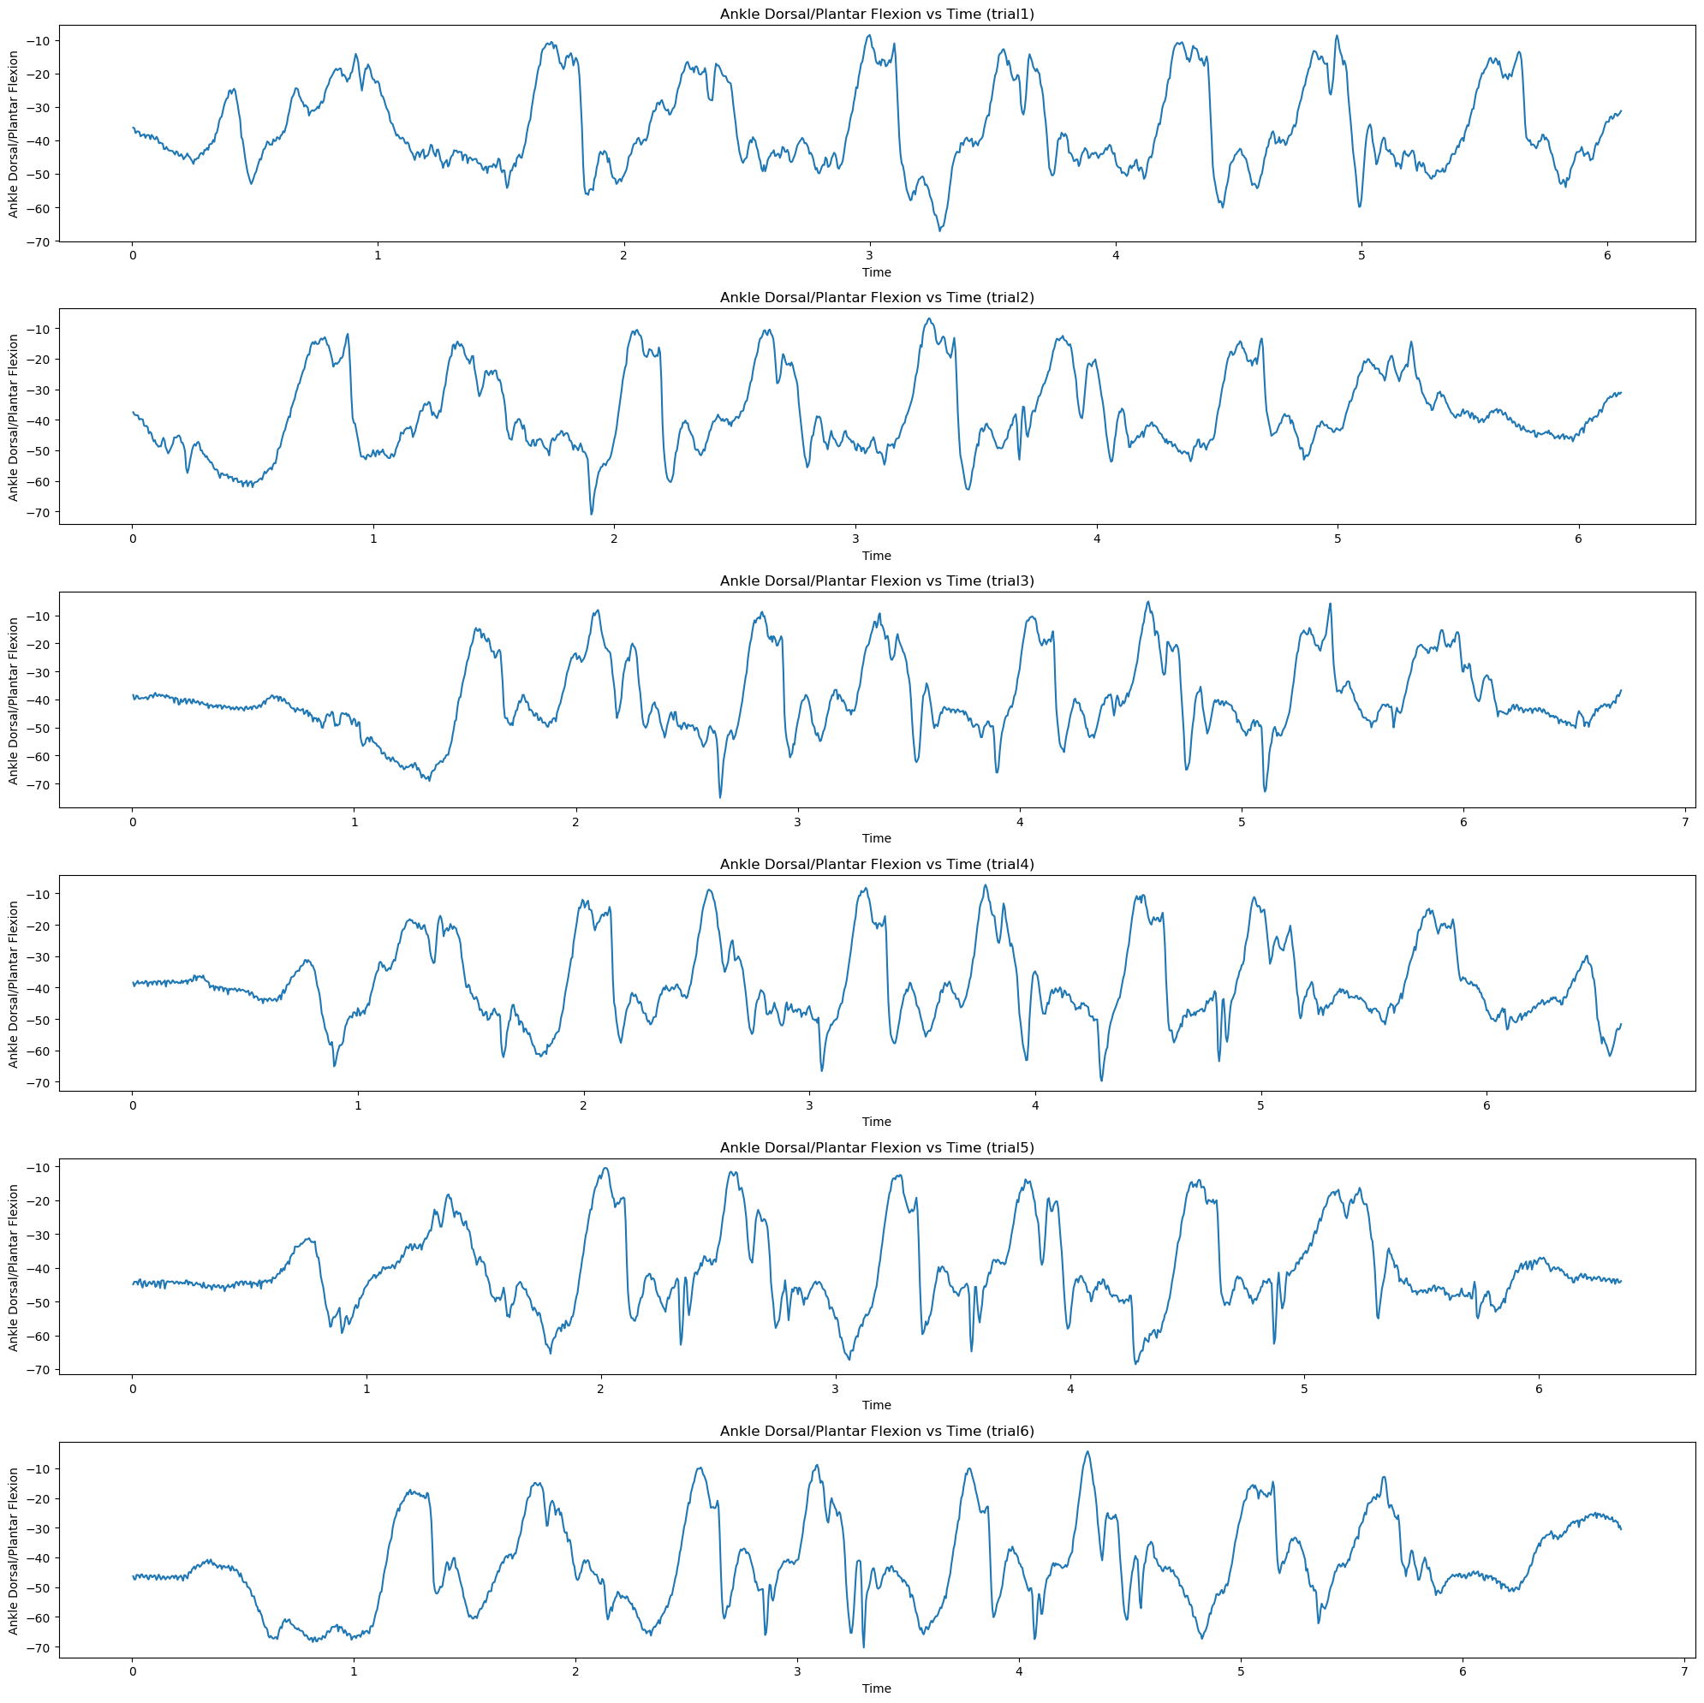
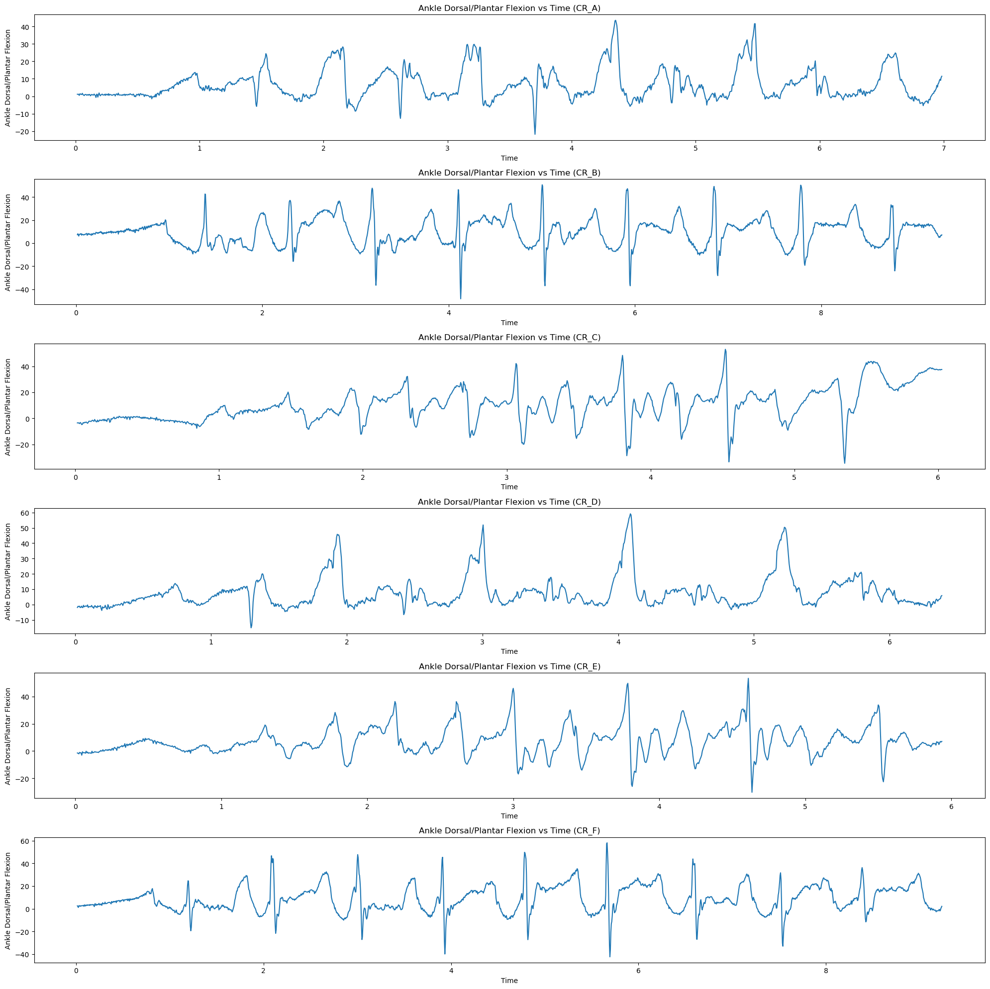
Experimental Data Force Values

Slide 7
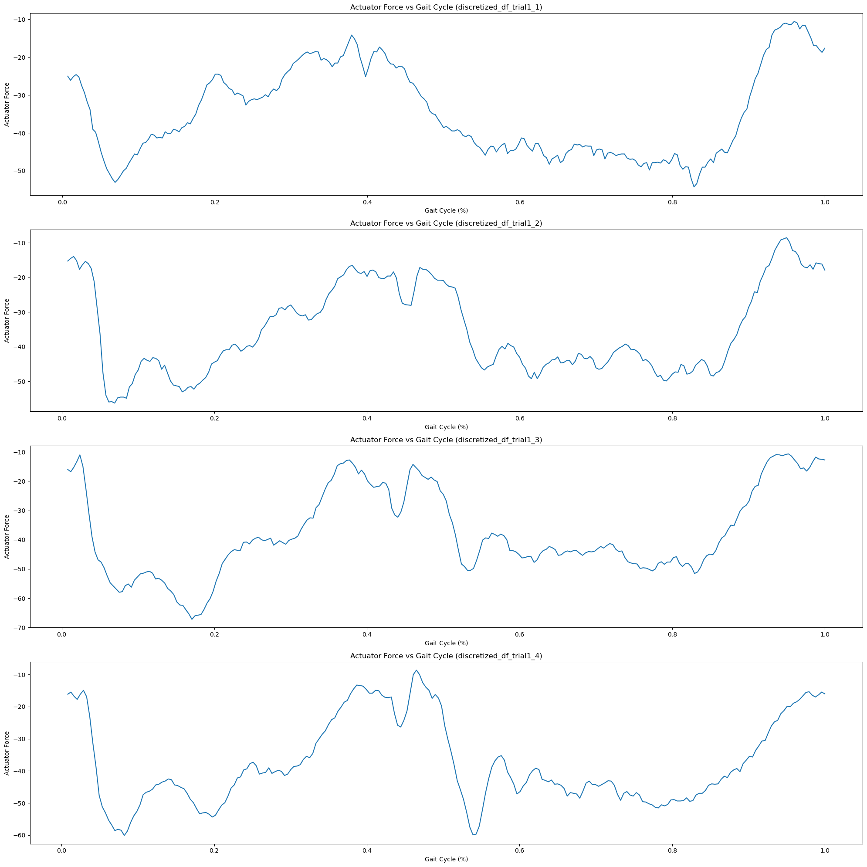
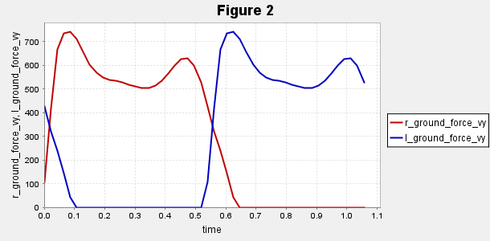
Experimental vs Simualtional Force Values
Ground Reaction Force Values
Normalised Force Values

Slide 8
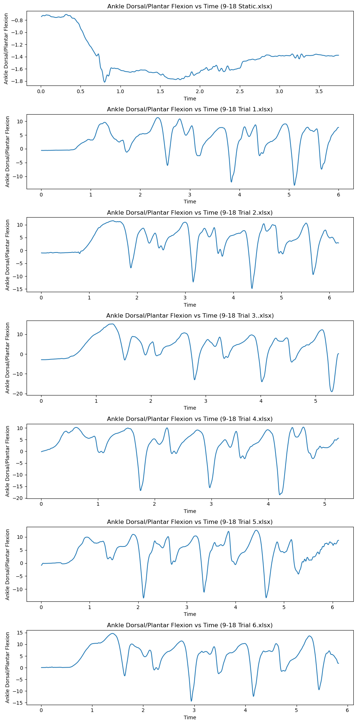
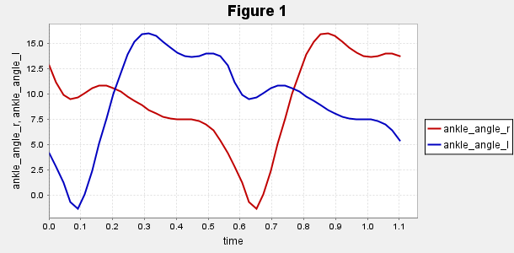
Ankle Joint Angles Experimental vs Simulation
Simulational Ankle angle Values

Slide 9
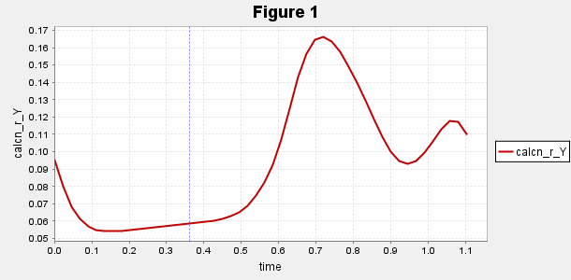
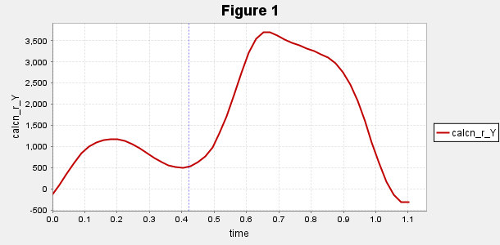
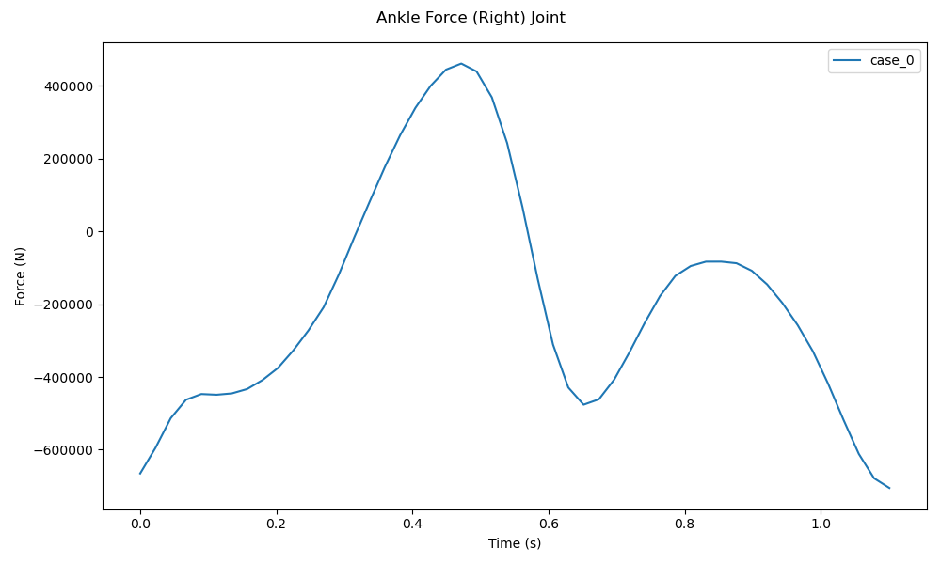
Foot vertical position and Acceleration w.r.t ground
Calcn_r distance from grnd
Calcn_r accelerations y_direction

Slide 10
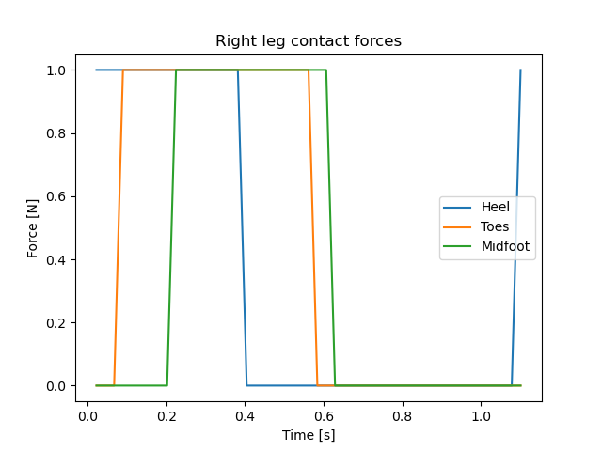
GRF forces aligned with contact timings

Slide 11
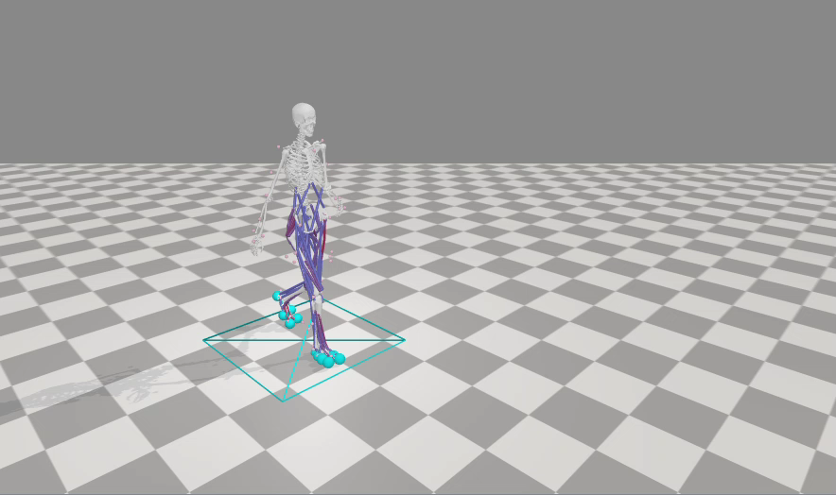
Maximum Isometric Forces
In OpenSim, maximum isometric force refers to the maximum force that a muscle can generate when it is held at a constant length (isometric contraction) and at its optimal length, without any shortening or lengthening

Slide 12
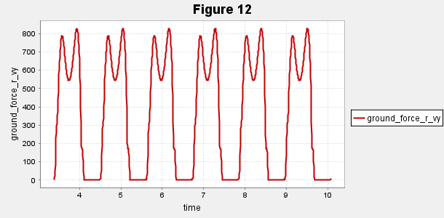
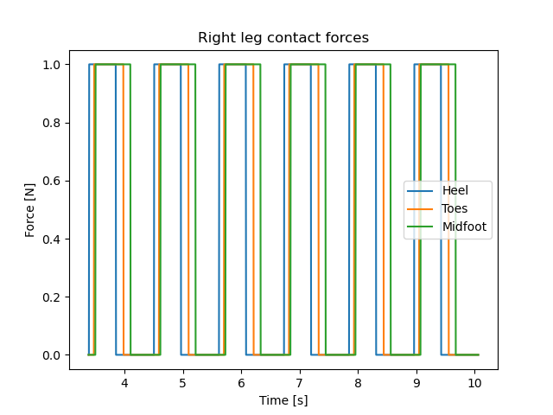
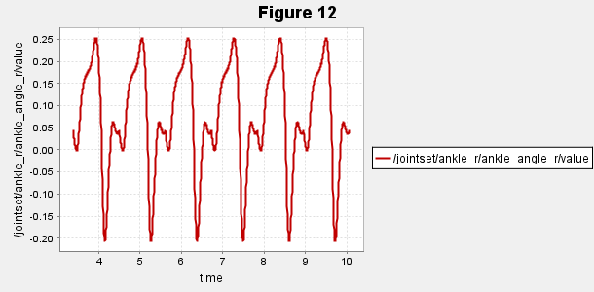
Extended Plots
GRF
Contact Timings
Ankle Angles

